Slide 1
The Art of Building SharePoint Business Solutions
Jared Matfess
Solution Architect, Slalom
#SPSNYC

Slide 2
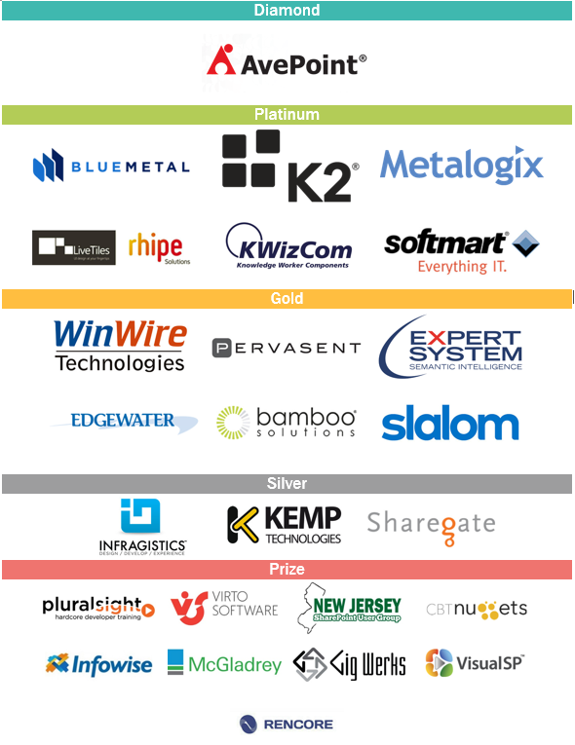
Thank You EVENT Sponsors
We appreciated you supporting the New York SharePoint Community!
Diamond, Platinum, Gold, & Silver have tables scattered throughout
Please visit them and inquire about their products & services
To be eligible for prizes make sure to get your bingo card stamped by ALL sponsor

Slide 3


About Me
Solution Architect with Slalom Consulting
10+ years in the IT Field
Happily married for 4 years!
President of CT SharePoint Users Group (www.ctspug.org)
Blog: www.jaredmatfess.com
Twitter: @JaredMatfess
E-mail: JaredM@slalom.com

Slide 4

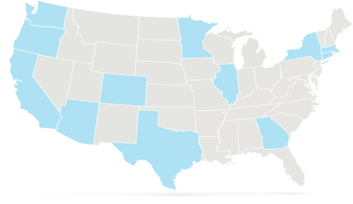





We bring business and technology expertise to help companies
Improve employee productivity
Improve enterprise performance
Drive innovation
Retain and grow customers
Key Differentiators
Balance of business and technology
National reach – locally based teams
Flexible, client focused delivery
Highly experienced consultants
SEATTLE (HQ)
PORTLAND
MINNEAPOLIS-ST. PAUL
BOSTON
SILICON VALLEY
CHICAGO
HARTFORD
SAN FRANCISCO
DENVER
NEW YORK
LOS ANGELES
PHOENIX
ATLANTA
DALLAS
HOUSTON
LONDON
Management Consulting Firm – Serving our Clients Locally
Founded in
Headquarters
3,000+
National Delivery Centers
13
2001
Seattle, WA
3
Employees Nationally
Years Strong

Slide 5







Areas of Expertise
We design and build strategies and systems to help our clients solve their most complex and interesting business challenges.
Improve collaboration, enhance IT efficiency, increase productivity, and engage customers through intuitive digital experiences.
Digital Strategy
Interactive Engineering
Experience Design
Product Incubation
Define your information architecture, taxonomy and governance strategy to not just connect your data, applications and people, but to empower them.
Software Engineering
Portals and Collaboration
Next Generation Infrastructure
Unleash business value from your processes and people through improvements in strategy, culture, and role clarity.
Change Management
Learning
Organization Design
Talent
Culture
Lead and Adopt Change
Realize the business value of your most strategic initiatives by making your methods and practices more agile to deliver results.
Program and Project Management
Business and Technical Analysis
Quality Assurance
Agile and Delivery
Link your strategic vision with executable techniques to gain alignment and drive untapped potential and value to your organization.
Strategy Advisory
Business Transformation
Performance Improvement
Mergers & Acquisitions
Create intimate, meaningful and authentic relationships that connect your customers to your brand by engaging with them on their terms.
CRM
Differentiated Digital Experiences
Marketing Execution
Customer Centric-Organizational Alignment
Customer Innovation Facilitation
Leverage the right data in your big data through a technology-agnostic approach to generate consumable information and enact solutions.
Data Visualization and Discovery
Information Strategy
Analytics
Data Management
Business Intelligence

Slide 6
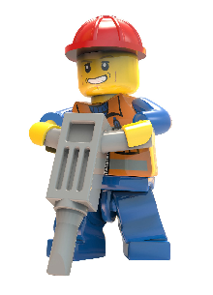
What am I covering?
SDLC & SharePoint Business Solutions
A brief primer on request processes / intake requests
Things to watch out for..
Demos.. ☺
Technology Stack:
InfoPath forms
SharePoint Designer Workflows
JavaScript

Slide 7

System Requirements
SP2013 On-Premises or O365
My demo is on a 2013 instance running on AWS
Site Collection Administration rights (helpful)
A passion to live, laugh, and learn

Slide 8

InfoPath is still alive…
InfoPath will still be supported in SharePoint 2016
End-of-Life = 2023
http://blogs.office.com/2014/01/31/update-on-infopath-and-sharepoint-forms/

Slide 9
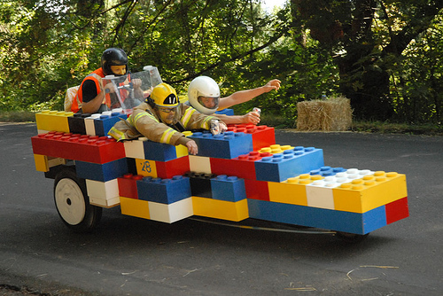
Quick rant on out of the box….
Notes:
Quick discussion about how out of the box is changing – even by Microsoft. It’s encouraging / recommending more customizations but doing so in a less harmful way. (Client side development) As users become savvy, you are going to see them building more of these hybrid solutions that leverage SharePoint web parts + client side development.

Slide 10
Software Development Lifecycle & SharePoint Business Solutions

Slide 11

SDLC & SharePoint Business Solutions

Slide 12

Planning for content promotion
Site Collection Backup & Restore
Helpful for initial development phases
Becomes unusable once you have production data
Manual Recreation
Mistake-prone & time consuming
Third Party Tooling
Can enable seamless content migration & transformation
Examples: ShareGate, AvePoint Content Manager, Metalogix Content Matrix, etc.
http://jaredmatfess.com/2015/06/software-development-lifecycle-sharepoint-business-solutions/

Slide 13

SharePoint Online / O365
There is no concept of Production / Staging / Development environments
You could create separate site collection(s):
http://pugley.sharepoint.com/sites/pugtastic
http://pugley.sharepoint.com/sites/pugtastic-QA
http://pugley.sharepoint.com/sites/pugtastic-Dev

Slide 14

What to do? It depends ☺
All solutions would benefit from at least more than 1 environment
Bare minimum recommendation:
1 Non-Prod site collection
1 Prod site collection
Have the tough conversation with your Enterprise Architecture team

Slide 15
Intake Processes

Slide 17

Real-world Examples:
SharePoint Site Collection Request
Employee travel/vacation request
Purchasing request
Light-weight Help Desk process

Slide 18

Why in SharePoint?
Because people will think you’re a total rock star!

Slide 19

The Typical SharePoint Business Solution
Several SharePoint Lists
SharePoint Workflows
E-mail notifications for status updates
Formatting of list items
List view web parts for “work-in-process”
Form(s) – InfoPath, K2, Nintex, Custom, etc

Slide 20
Things you need to watch out for…

Slide 21

List view throttling

Slide 22
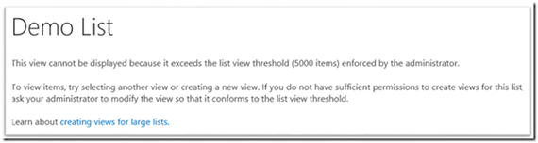
What is that again?
SharePoint has a boundary that only 5,000 items can be returned in a single view
Auditors & Admins are restricted to 20,000

Slide 23
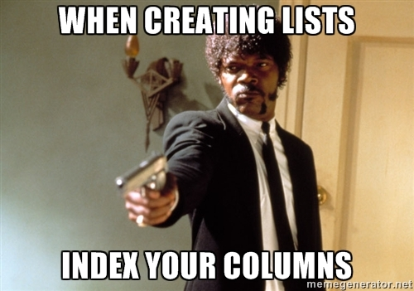
Samuel L. Jackson says…

Slide 24
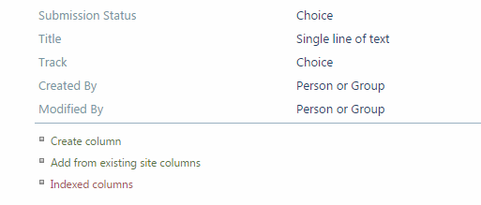
Here’s the link… Click it.. Trust me..

Slide 25

Security or Obscurity?
How sensitive are your requests?
Search or don’t search?
Break inheritance on list items?
“App Step (Step-by-Step) break permissions inheritance on item https://msdn.microsoft.com/en-us/library/office/jj822159.aspx

Slide 26
Demo
“Some tips & tricks”

Slide 27
Utility Functions

Slide 28
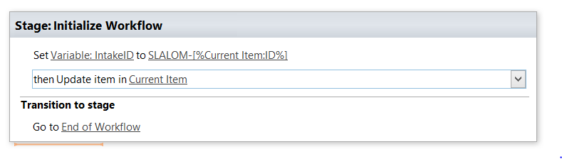
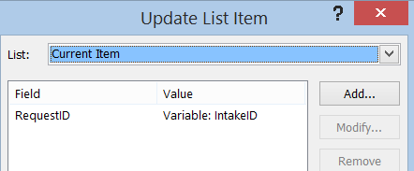
Pro-Tip: How to create a Request ID
Notes:
SharePoint will automatically assign your items ID numbers. You can always do some sort of a concatenation with the Item ID plus whatever naming scheme you have. This example is Slalom-ID (Item ID number)

Slide 29


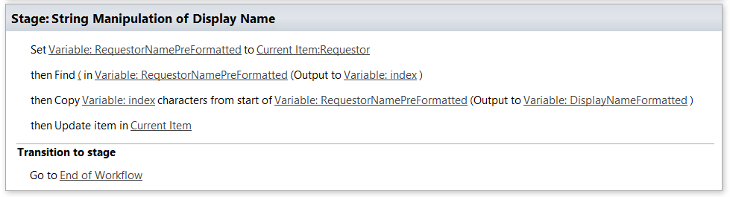
Pro-Tip: String Manipulation not like String Theory!
Notes:
Step through the

Slide 30
How to promote InfoPath Form across environments

Slide 31
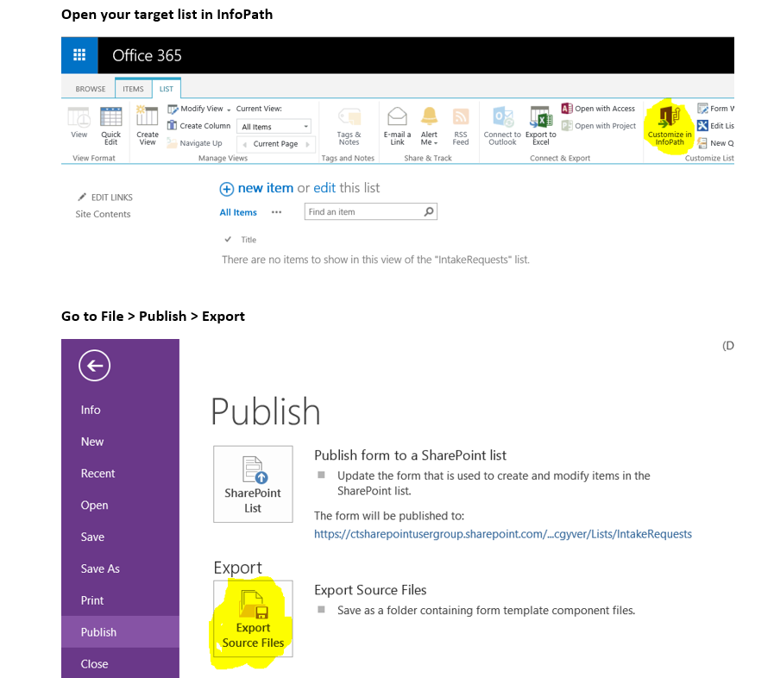

Slide 32
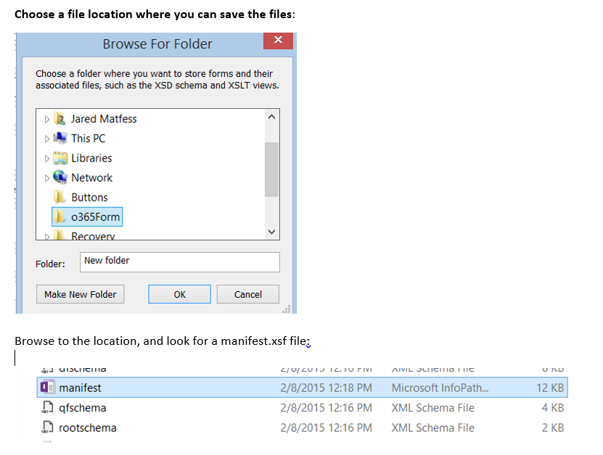

Slide 33
Find this key line in the manifest.xsf
Do a Ctrl + F for the siteURL value in the manifest file
Update the siteURL to point to your new environment
You might need to update the GUIDs for sharePointListID & contentType
Right click on the manifest.xsf and select Design
Publish as normal

Slide 34
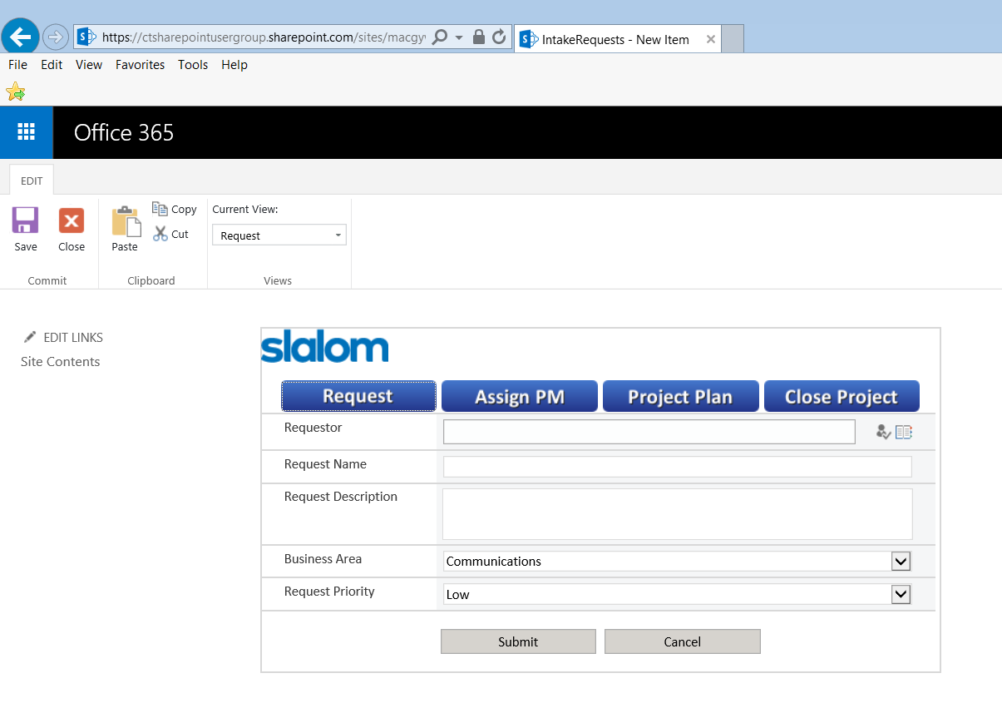
Success!

Slide 35
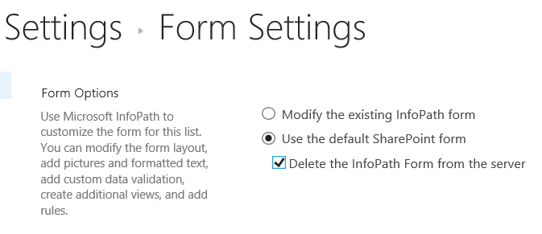
Pro-Tip: Promoting to site with InfoPath Form already
If you’re promoting an InfoPath form to a site where there’s already an existing InfoPath Form (use case of application enhancements) – sometimes things go bad
Don’t be afraid of nuke the existing form out of existence!

Slide 36
Step by Step: Building a SP2013 Workflow with a Loop Step

Slide 37
Background & Use Case
Loops are incredibly powerful just like in application development
SharePoint 2013 includes a new Loop step which allows you to iterate through a collection of items
It’s also pretty poorly documented on the Internet ☺

Slide 38
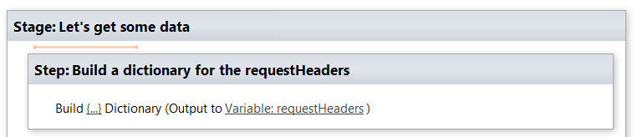
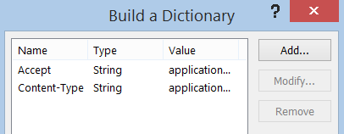
1. Create a dictionary with Accept & Content-Type
Value = application/json;odata=verbose

Slide 39
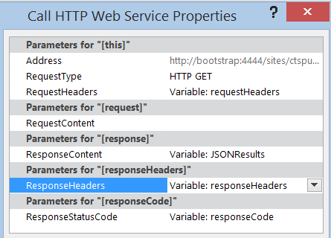
2. Add a call a web service action
* Each variable is of Dictionary
http://bootstrap:4444/sites/ctspug/_api/web/lists/getbytitle('Fake%20Data')/items?select=Title,RequestID

Slide 40

3. Find out how many items you’re looping through
Add a “Get an Item from a Dictionary” action
Retrieve d/results from previous JSONResults dictionary
Output to the resultsCount variable (dictionary)

Slide 41
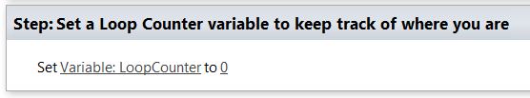
4. Create a Loop Counter variable
Most examples on the Internet forget to include this vital step for actually traversing through each list item

Slide 42
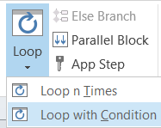
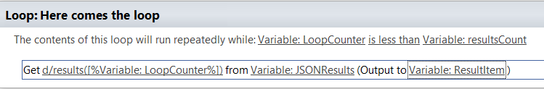
5. Start to build out your loop
Add a Loop with Condition action
Set the condition of LoopCounter is less than resultsCount
resultsCount is how many items were retrieved via the web service call
Add a Get item from Dictionary step
d/results([%Variable: LoopCounter%]) from JSONResults dictionary
Output to new Dictionary variable called ResultItem

Slide 43
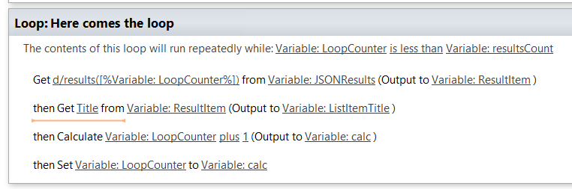
6. Complete loop
Add get Item from Dictionary action – remember to use *internal* column name
Calculate the LoopCounter + 1 to increment the counter
Assign the Loop counter it’s new value

Slide 44
In Closing…..

Slide 45
Summary
Intake processes can be fun, if that’s your thing…
Loops are awesome, check them out..
You might need to dabble in some JavaScript here and there..
Remember to tip your waiter

Slide 46
Resources
GitHub – Awesome Source Code!! https://github.com/JaredMatfess/SPSBoston2015
JSLink CSR (Production code): https://github.com/spcsr
SharePoint REST Endpoints https://msdn.microsoft.com/en-us/library/office/ff521587(v=office.14).aspx
Great multi-part series on REST https://chrisstahl.wordpress.com/2014/05/29/getting-started-with-rest-in-sharepoint-2013-part-i/

